Slide 1
TRC #33 and 34—Call for an Indigenous Approach to FASD
Re-balancing the Wheel at the Eastern Door
Lori Vitale Cox PhD
Director Elsipogtog Eastern Door Center

Slide 2
Need Culturally Safe FASD Services
FASD is a neurodevelopmental condition that adversely affects the health and well-being of Indigenous people all over the world
Access to FASD services are limited and access to culturally safe services almost non-existent

Slide 3
PAE and Development
FASD refers to spectrum of conditions related to the prenatal alcohol exposure (PAE)
Exacerbated by risk factors associated with adversity
Can lead to problems with learning, memory, attention, language, social behavior, executive functioning, sleep and affect regulation
PAE can affect all aspects of development

Slide 4

Heart
Emotional
Mind
Mental
Spirit
Social
Hand
Physical
Notes:
I am very honored to be here today to open the first New Brunswick Circle of Hope Conference on FASD

Slide 5
Myth FASD Only An Indigenous Issue
FASD can affect individuals of any race or ethnicity--the children of judges or janitors
But FASD adversely affects Indigenous people
Structural health inequities lead to health inequalities—lack of good water, housing, food
Lack of access to early diagnosis, adult diagnosis appropriate health and family services that are life-long as needed

Slide 6

TRC Calls to Action
In 2015 the Truth and Reconciliation Commission of Canada, TRC, called for Canada to collaborate with Indigenous people to develop FASD services

Slide 7
Why TRC Calls in the Justice Section?
Without FASD health services spiraling behaviors leading to an array of problems in terms of mental health, addictions, education and the legal system.
Research indicates up to 60% of people with FASD get in trouble with the law
Indigenous people make up 32 percent of the federal prison population despite accounting for less than five percent of the total population

Slide 8
Sweden Study
In some European countries where FASD health services are accessible early and continue life-long
There is no association between FASD and trouble with the law--rates of criminality in between FASD sample and controls were not statistically different (Rangmar J. et al Pediatrics 2015)
In Canada the root cause of behaviors due to FASD disability are often interpreted as criminality

Slide 9
TRC Call to Action 33
“We call upon the federal, provincial, and territorial governments:
To recognize as a high priority the need to address and prevent Fetal Alcohol Spectrum Disorder (FASD), and
To develop, in collaboration with Aboriginal people. FASD preventive programs that can be delivered in a culturally appropriate manner.”

Slide 10
TRC-Call to Action 34
The Truth and Reconciliation Commission calls upon the governments of Canada to make reforms to the criminal justice system to better address the needs of offenders with Fetal Alcohol Spectrum Disorder (FASD), this would include:
1. Increasing community resources and powers for courts to ensure that FASD is properly diagnosed and that proper support systems are in place for individuals with FASD.

Slide 11
TRC-Call to Action 34
2 .Establish situational exceptions from mandatory minimum sentences for offenders affected FASD.
3. To maximize the ability of people with FASD to live in the community by providing community, correctional and parole resources.
4. To adopt evaluation methods to continuously ensure the effectiveness of such programs and ensure community safety.

Slide 12
In This Webinar
Government Action--What has the government done to collaborate with Indigenous people on the development of FASD service delivery programs that are culturally safe and sensitive-prevention, diagnosis and support services in the community
Indigenous Community Action—Discuss what one Mi’kmaq FN has done to develop a Two-Eyed Seeing approach to FASD that is based in the Medicine Wheel

Slide 13
Government Action
Government TRC website developed to details the progress https://www.rcaanc-cirnac.gc.ca/eng/1524502695174/1557513515931

Slide 14
TRC-33
Primarily 2 FASD Federal programs dealing with FASD prevention and awareness—Part of FASD Strategic Plan-2003
Public Health Agency of Canada (PHAC)
National Strategic Fund
Indigenous Services Canada (FNIH-ISC)
Indigenous Project Fund

Slide 15
Progress Since 2015—Pre-Post TRC
National Strategic Project Fund
Funding level remains the same
Indigenous Project Fund
Additional $10.5 million over 5 years added to 14.2 million annual allocated before TRC

Slide 16
TRC #33-Minimal Increase Funding
Taking inflation into account the funding increase is inadequate in terms of developing an Indigenous approach to FASD
About $ 2000 each of 687 FN+ Inuit communities
Not including allocation of funding for FASD health services for Indigenous people living in the city or off-reserve

Slide 17
TRC #34 ---Action-Minimal
34-1--Government does not report any action taken in terms of access to diagnosis in the CJS
34-2-No exemption for offenders with FASD from all mandatory minimums—simple drug minimum exemption for all
34-4-Research article commissioned on Evaluation
34-3- No increase in federal funding for community alternatives such as the Healing Lodge Program-Yet

Slide 18
Community Alternatives Do Work
Indigenous Healing Lodge Program--community based corrections operating since 1990’s -8 Lodges-3 Federal
A significantly higher rate of success (78% vs 68%) than correction facilities
Success led to a women’s lodge in Manitoba built without federal funding through province and private partnership

Slide 19
Other Initiatives That Give Hope
Healing to Wellness Courts
Not specific to FASD but have direct impact
Therapeutic approach in Indigenous communities
Focus rehabilitation not renunciation or deterrence
~ 47 operating before TRC report published
13 additional Indigenous community courts

Slide 20
Other Initiatives That Give Hope
Court-worker Program –Gladue report--information regarding trauma based conditions like FASD to mitigate sentencing
ACIS Program Assistance In Community Integration------adult program--recent youth re-integration pilot
Manitoba FASD Court – 2019- Mary Kate Harvey

Slide 21
Research Supports TRC Call 34
TRC-34-1, 34-2, 34-3, 34-4
34-1 Professional Practices in FASD Among Forensic Mental Health Clinicians (2020 McLachlan)
34-3 Exploring the Use of Restorative Justice with Offenders with FASD (Evans and Bourgon 2020)
34-4 FASD and TRC Call to Action 34.4-Consideration of Evaluation Methods (Bell et al 2019)

Slide 22
Government Progress Summary
Action– Nothing new (yet) from government either in program or policy
Recognition—ISC and PHAC recognize FASD is a complex health issue affecting Indigenous people coming into conflict with the law
Public Consultations —To develop an Indigenous Justice Strategy and also a national FASD Strategy

Slide 23
PHAC Commisioned FASD Research
Canadian Academy of Health Sciences
Includes an Indigenous panel and Justice section
Public Consultations with Indigenous groups
This work will inform:
FASD bill in the senate passed the first reading
Canada’s next FASD Strategic Plan

Slide 24
Hope
Government is like a big ship and it seems to take them a while to change course
On local level in and out of Indigenous communities much work being done
But many people continue to ‘fear’ the stigma of diagnosis

Slide 25
FASD Prevention
Elders tell us that we can create what we fear
For how can we prevent what we do not see
Access to functional diagnosis and the supports that follow are key to FASD prevention
One community’s journey working through the stigma and developing a community based approach to FASD and FASD prevention

Slide 26

Eastern Door Centre
Eastern Door Center in Elsipogtog FN opened in 2006
It offers an approach to FASD and related disorders that integrates traditional knowledge and health science
Concept of Two-Eyed Seeing
Informs our work

Slide 27
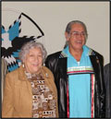
Acknowledge M’igmag Elders Murdena and Albert Marshall
Originated concept of
Two-Eyed Seeing

Slide 28
Two-Eyed Seeing
In Two-eyed seeing
One eye looks through a traditional lens
One eye looks through a scientific lens
Looking in this way gives more depth in perspective

Slide 29
TES at the Eastern Door Centre
Diagnostic Team-Half of the team have roots in the community--Elder healer and Physician
ED School Specialist Team
ED Family and Youth Support Team
Nogemag Youth Lodge Team
On the Land Healing
Research and Data Collection
ED Prevention of PAE-- with Health Center
Wellness Court-ED collaboration for Gladue report

Slide 30
Story Of Two Brothers
Two brothers born to a mother with alcohol problems
Mother drank in both pregnancies until delivery
Never told in either pregnancy that drinking might be harmful
Older brother E.
Younger brother L. who was 6 years younger

Slide 31
The Story Of Older Brother E
By the time E was 10
He was smoking, sniffing and drinking
He had difficulty in school---often suspended
Family life chaotic and unstable during early years
At 11, he was sent to a Manitoba youth treatment centre because of his sniffing and drinking

Slide 32
The Story Of Older Brother E
When he returned he started stealing
Sent to youth correctional facility for few months
Returned to community but no follow-up
Continued offending-stealing, assault, vandalism, mischief, drinking, uttering threats
Sent to live at a group home in Moncton

Slide 33
The Story Of Older Brother E
E attended school while living at the group home
With the structure he started to work on basic skills
He was due to be released mid year in April
He attempted suicide just before release
Sent to a psychiatric group home in Fredericton
At 16, E. returned to community but no support
He continued to drink, to get in trouble with law
Dropped out of school--Unable to hold down a job

Slide 34
The Story Of Older Brother E
Primary Disability
Prenatal Exposure To Alcohol- Family Trauma
Lack of assessment and diagnosis
Lack of appropriate interventions
Lack of family support and stability

Slide 35
The Story Of E.
Lack of FASD Services Lead to Secondary Problems
School suspensions
Alcohol and drug problems
Periods of institutionalization
Mental health problems-suicide attempt
Work problems
Ongoing trouble with the law

Slide 36
The Story of Younger Brother L
The story of L starts out the same:
By the time L was 11
He was smoking, sniffing and drinking
Had difficulty in school and often suspended
His family life was chaotic in his early years because of family alcohol problems
He began stealing

Slide 37

The Story of Younger Brother L
The paths of the brothers diverge when L was 11

Slide 38
Eastern Door Beginnings
L was identified by teachers as part of an in-depth needs assessment at the FN community school
Undertaken by a community group made up of agency directors, Elders and service professionals
Needs assessment was in response to youth suicide crisis and subsequent inquest in the community
This was a Two-eyed seeing assessment--informed by input from Elders

Slide 39
Eastern Door Beginnings
The parents of youth identified by teachers as having needs in multiple domains were interviewed to explore their developmental history
All of the children identified by the teachers had experienced some developmental trauma
Multiple areas of needs were identified by the parents and the teachers—mental, emotional- social, physical and spiritual

Slide 40
Youth Needs Assessment Findings
Many mothers disclosed drinking and smoking during pregnancy
Like E and L’s mother, women in the community were informed by local doctors that moderate beer and wine consumption was safe during pregnancy
Two diagnostic clinics were held in the community through a collaboration of a provincial pediatrician and community health center and school staff

Slide 41
High FASD Prevelance
Many health needs were identified
Some children needed glasses, some had hearing problems or problems with speech or grief
We were able to refer these children for services
~20% of the children at the school were diagnosed with FASD
There was little information about the condition at the time and no where to refer for support
Like E many of these youth were getting in trouble

Slide 42
Original FASD Cohort-Behavior
Drinking |  | Percent
 | Unknown | 9.4
 | Yes | 66.0
 | No | 24.5
 | Total | 100.0
66% early drinking (Pre-Middle School)
69.8 early smoking (Pre-Middle School)
62.2% early onset drug-use (Middle School)
11.3% inappropriate sexual behavior
66% youth in trouble with the law
32.1% youth charges
9.4% youth detention

Slide 43
Youth (PAE) in Trouble With Law
Sample 44 youth FASD (36) /PAE (8) ages 11-14*
66% Trouble With Law (some more than one charge)
39% Theft
19% Break & Enter
22% Vandalism
15% Assault
21% Running Away
12% Attempted Suicide

Slide 44
Story of L
L was one of the children diagnosed with FASD at the school and he was able to get support in school
The community submitted a funding proposal to Indian Affairs for school support
A resource and mentoring program established in the school
At the same time L’s mom attended a culturally based treatment centre in the community that had recently opened–Lone Eagle
She also began a long-term stable relationship

Slide 45
Path of Younger Brother L
School suspensions stop
Trouble with the law stops
His drug and alcohol problems stop
Graduated high school
Now working and has a family of his own
Part of L’s success was his participation in Nogemag Youth Lodge summer on the land program—as youth leader

Slide 46
Nogemag Lodge--On-The-Land
The Nogemag Healing Lodge program for opened in 2001 with youth renewal funding
In response to the high rates of youth crime in the community especially those living with FASD
Program for youth to connect with Elders and the land to strengthen relationships to self, to the world around and to creator

Slide 47
Older Brother E at Nogemag
We had been able to help L
His brother E continued to have on-going trouble with the law
At 21, facing a sentence of 2 years for assault
The mother of the two brothers asked us for help
We talked to the crown and defense
Presented combined recommendation to the judge
E went to Lone Eagle for treatment and then served 2 year conditional sentence at Nogemag

Slide 48
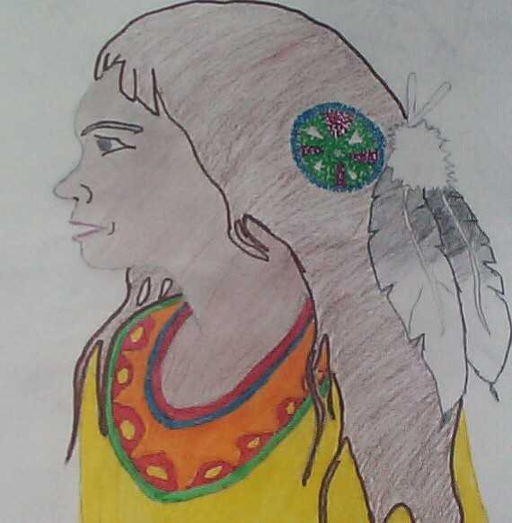
Nogemag Healing Lodge For Youth
E had no contact with the CJS for those 2 years
If he started to drink we held Elder-led circles for him with his mother and Nogemag staff

Slide 49

Nogemag Healing Lodge external evaluation indicated that the youth crime rate in the community significantly decreased. (Clairmont 2004)

Slide 50
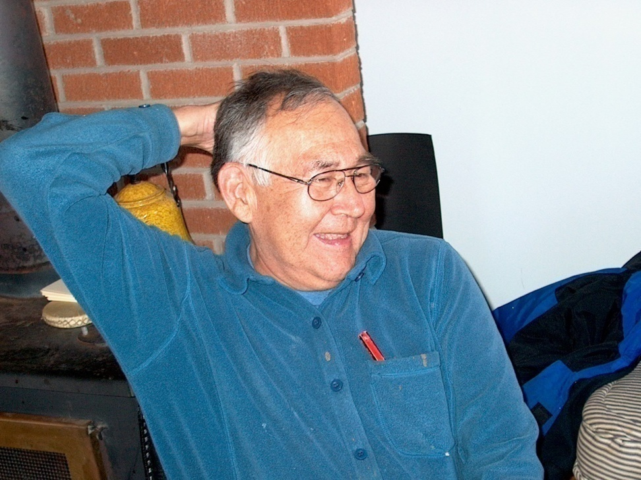
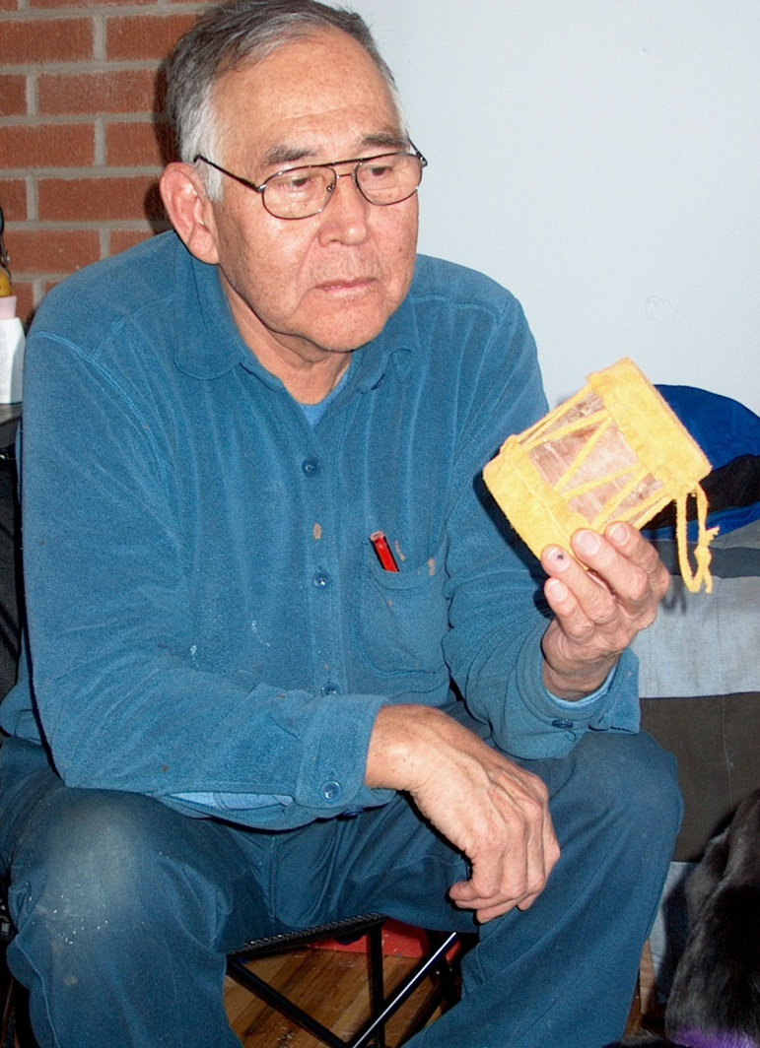
Elder Peter Clement Teaching Youth Traditional Skills

Slide 51
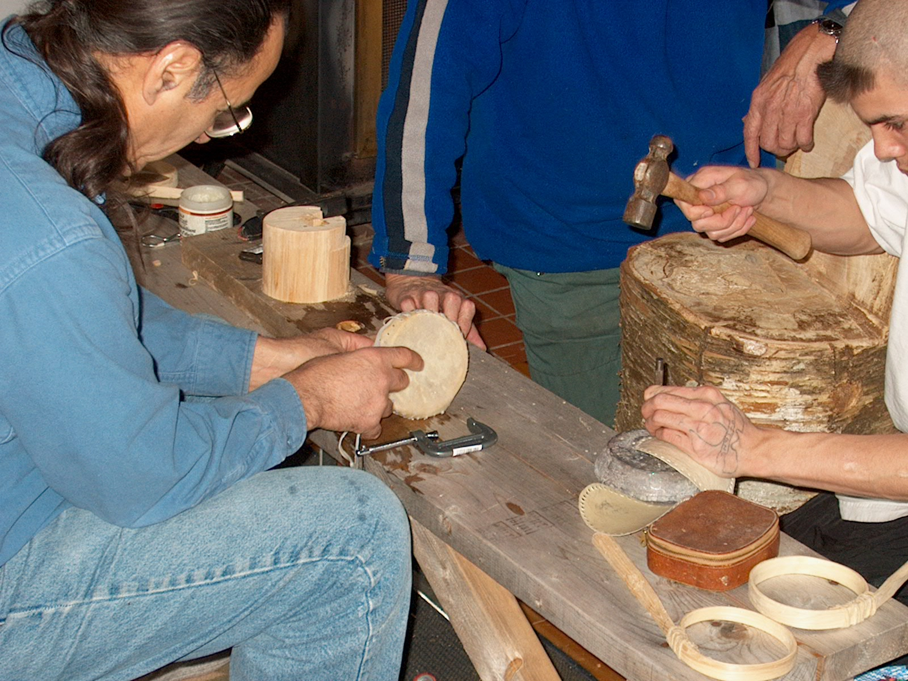
Elder Ray Solomon
Making Hand
Rattles

Slide 52
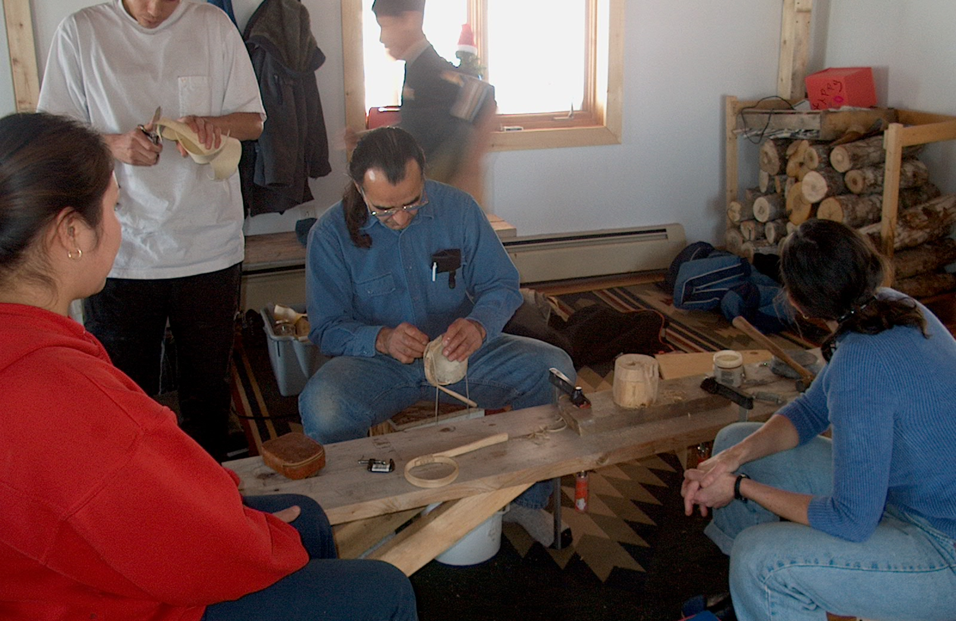

Slide 53
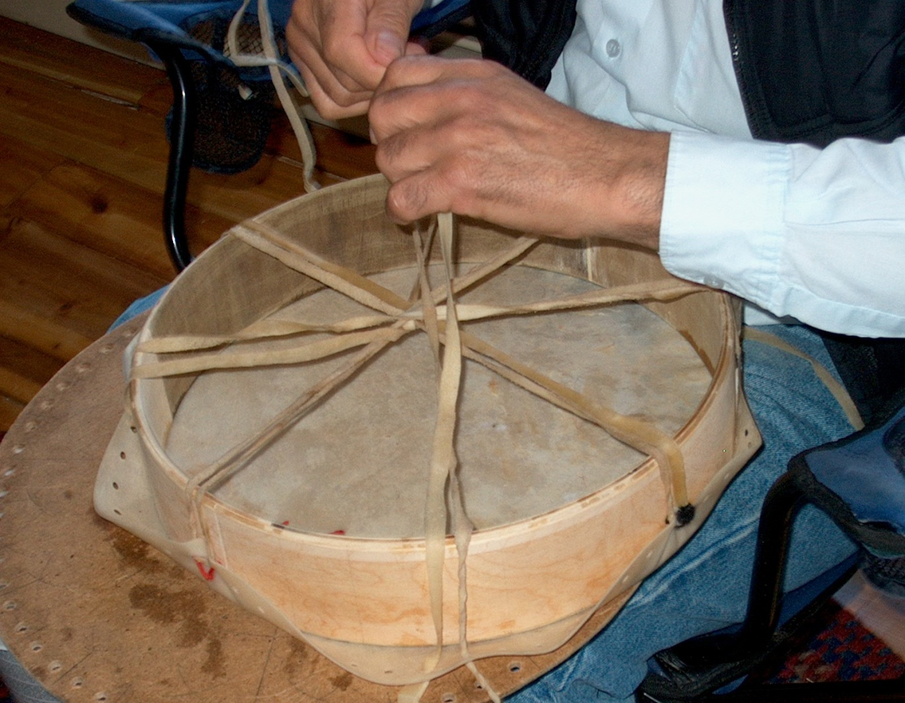
Making Drums

Slide 54
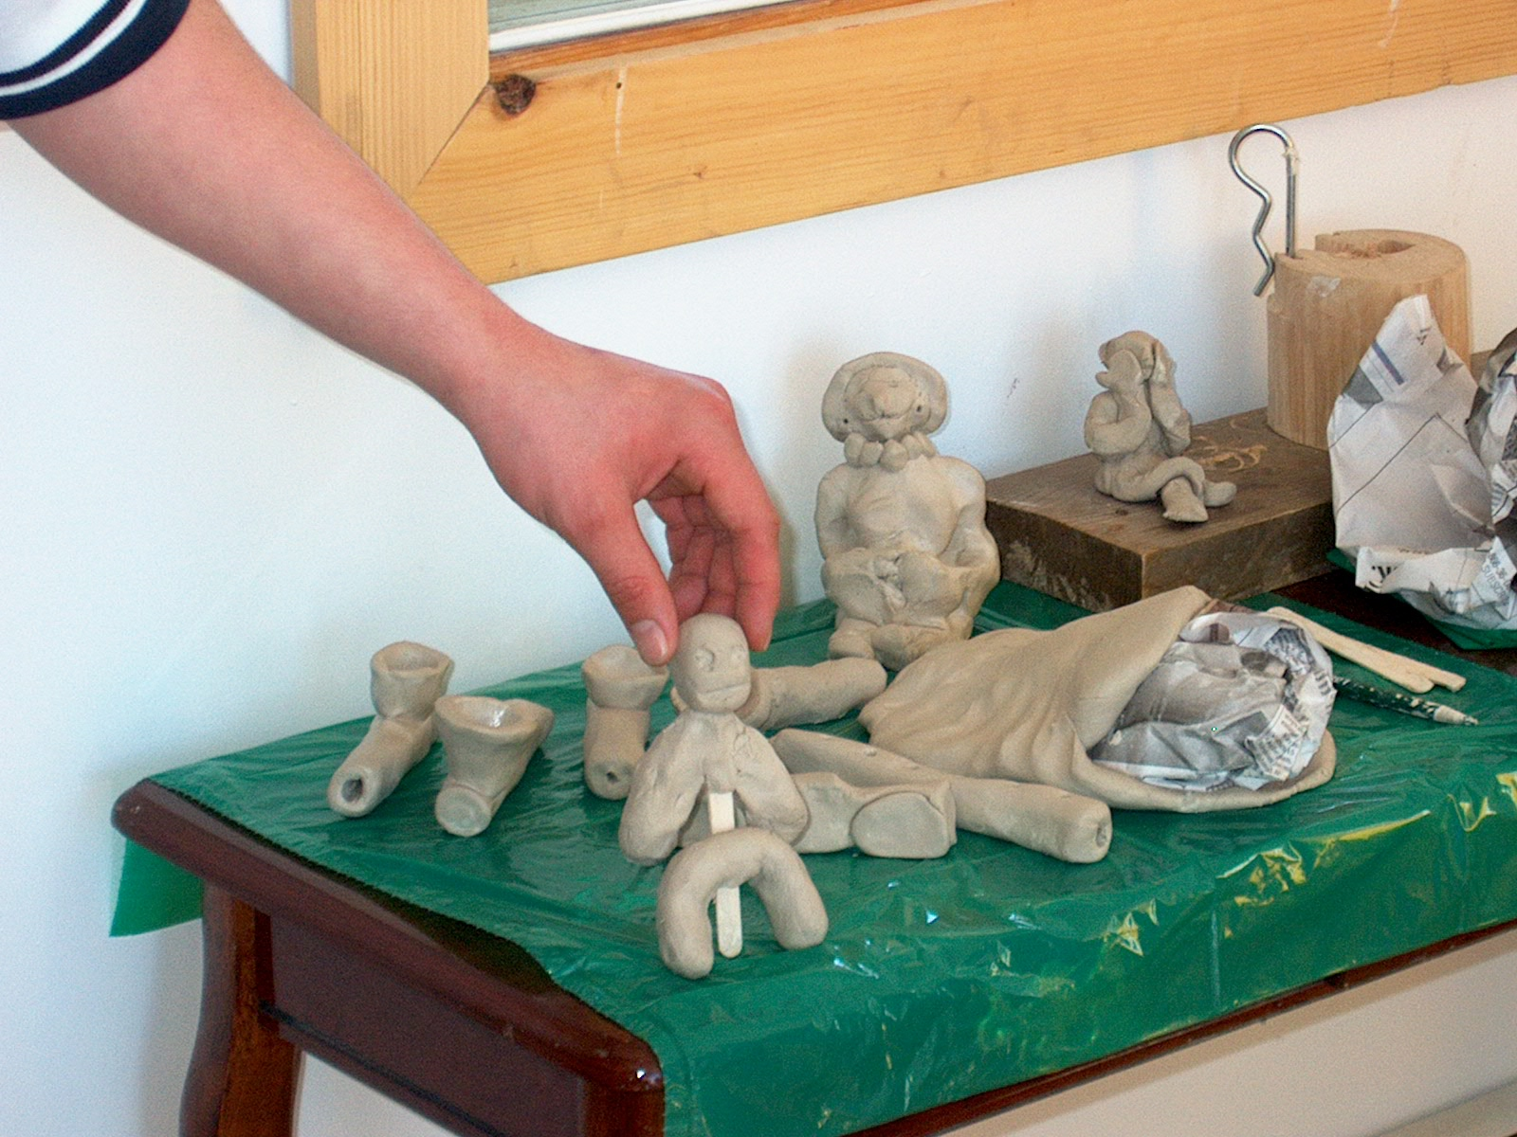
Working With Clay

Slide 55
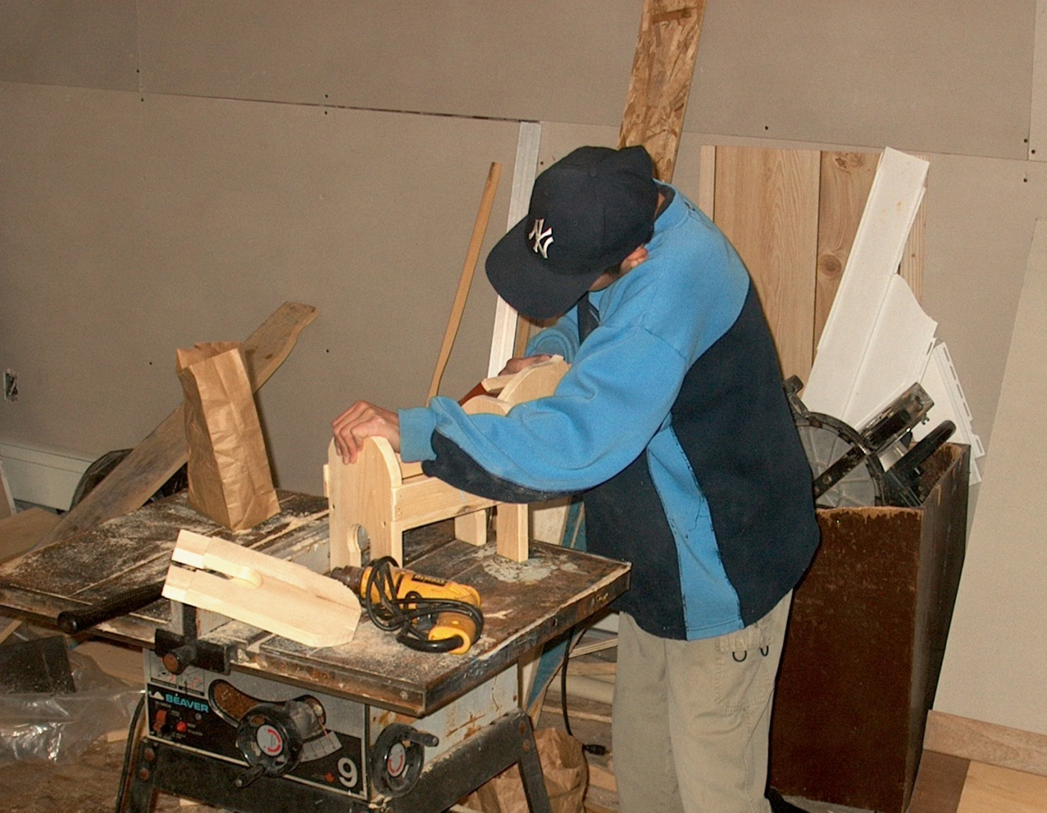
Working With Wood

Slide 56
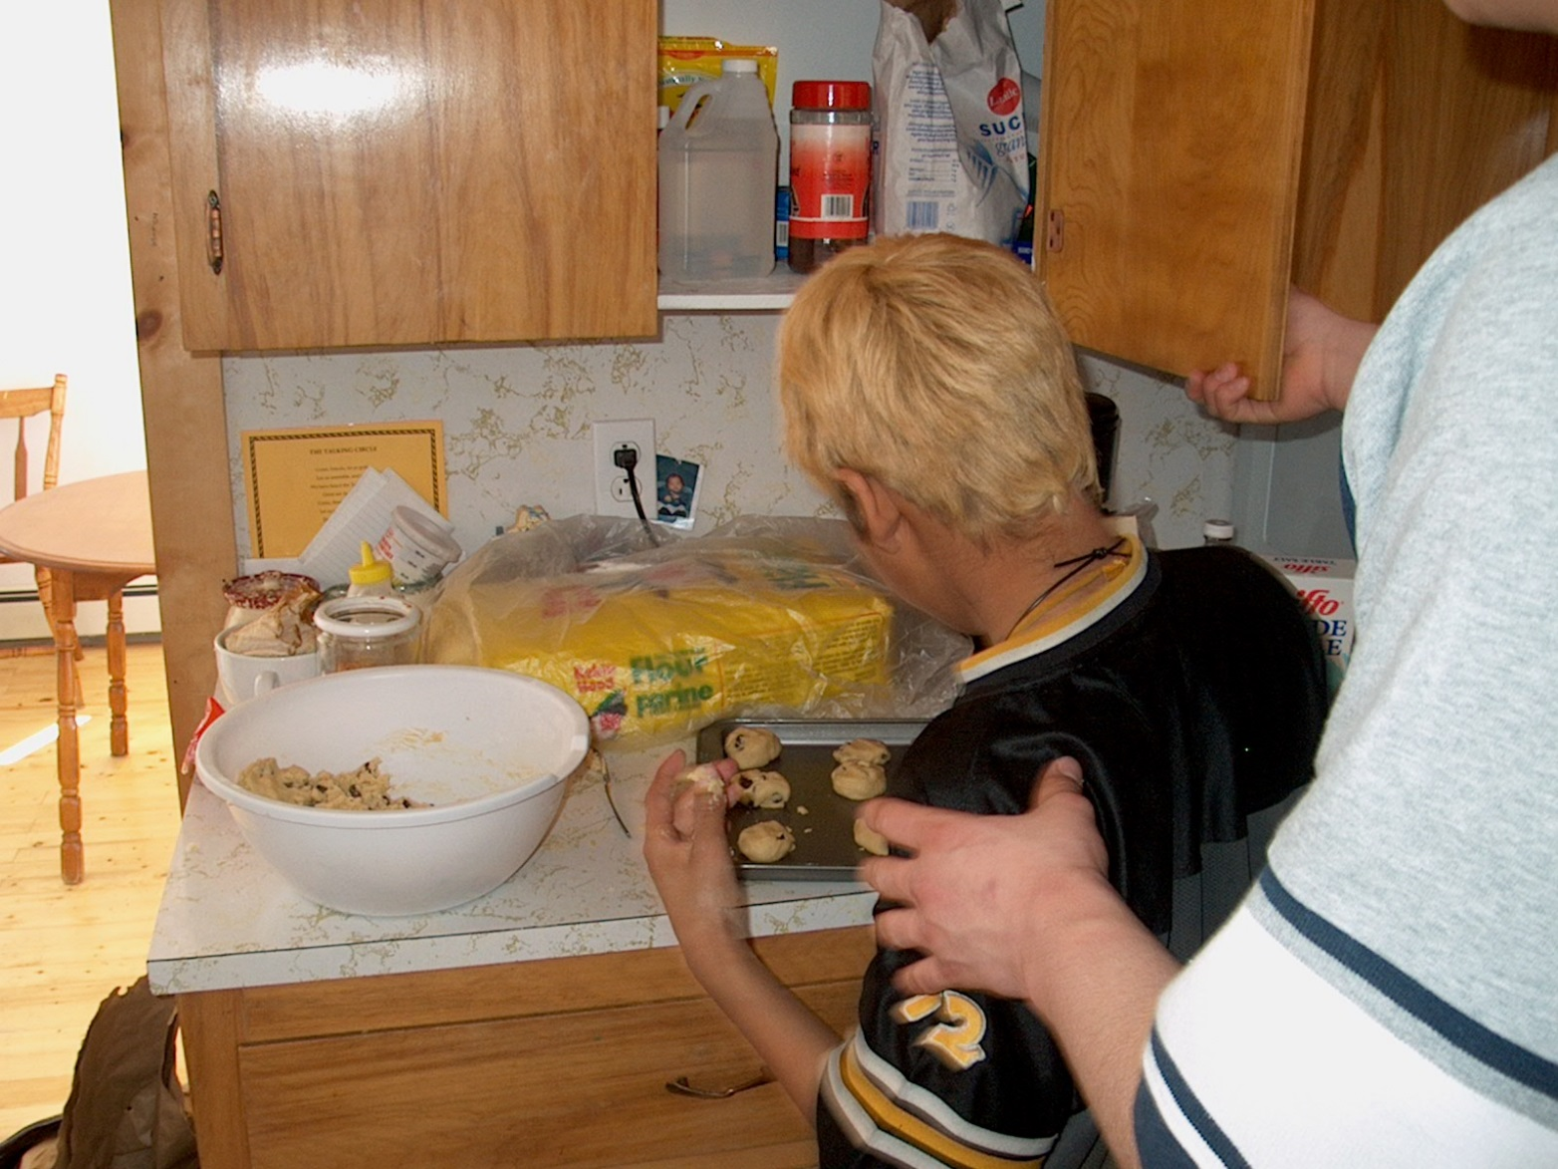
Cooking and Baking

Slide 57
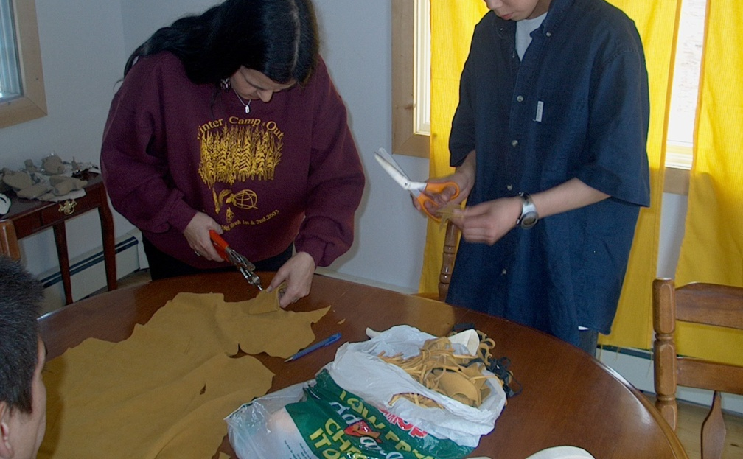
Making Medicine Pouches

Slide 58
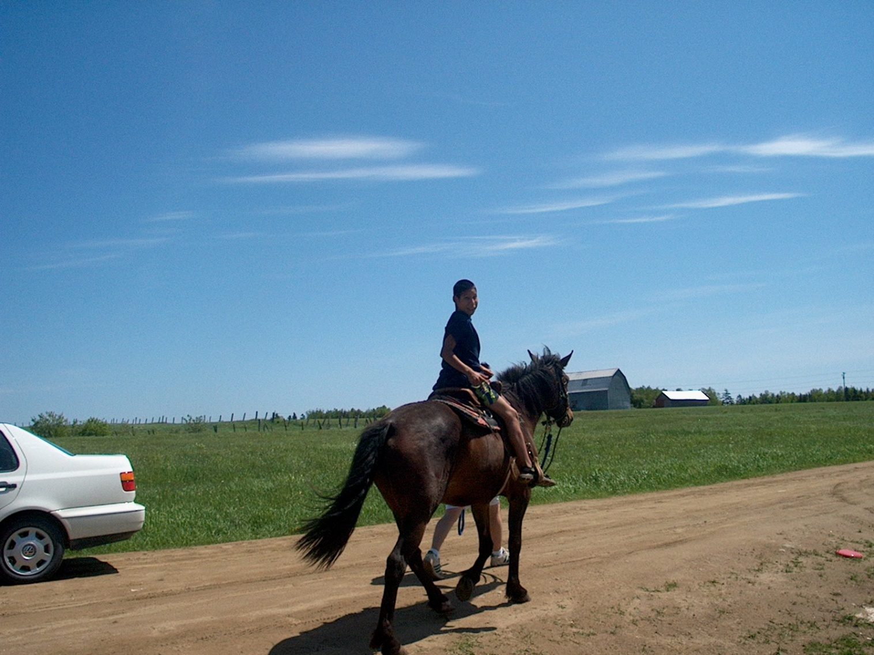
Working on the Land and With Animals

Slide 59
Nogemag Outcomes
After 2-3 years all youth back in school
Nogemag youth participants
~73 % Graduated HS and/or go on to to post-secondary
Youths who did not graduate HS
Continuing family instability—Unstable family placements with no family support

Slide 60
FASD Prevention Risk and Protective Factors
Access to early diagnosis
Accommodations at school
Support and stability at home
Relationships in community
Healing of heart, hand, mind and spirit

Slide 61
Eastern Door Prevention
ED prevention model is distinct from that of the PHAC (Public Health Agency) model
It is a Medicine Wheel TES approach
Takes in generational and family system healing
Includes the fathers as well as mothers
Social relationships
Cultural and Spiritual balance

Slide 62
Eastern Door FASD Prevention Model
North
Prevent PAE
Community Healing--DoH
Awareness, Education
Reduce cultural and spiritual risk factors
West
East
Prevent
Generational FASD
Youth FASD having baby FASD
Mother having another baby
PAE
Prevent PAE
Reduce Effects PAE
Early Screening
Pre-Diagnosis
Interventions
FASD
Prevention
Prevent
Secondary Conditions
Early Diagnosis
Support
South

Slide 63
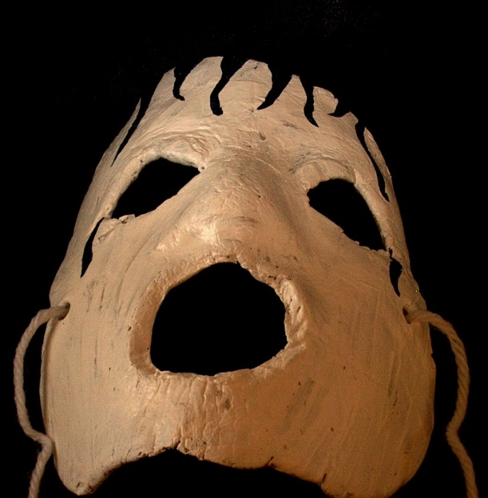
Medicine Wheel Tools
Eastern Door has developed its own MW Tools for a culturally based approach to prevention, diagnosis, intervention and research—individual, family and community healing

Slide 65
Two-Eyed Seeing MW Diagnosis
Diagnosis includes family and generational trauma
Residential and day school, mental health, grief, trouble with the law, trouble with relationships family violence—multiple factors
Also allows for diagnosis of other trauma based neurodevelopmental conditions—not just FASD
Functional diagnosis that leads to support based on pattern of strengths and challenges

Slide 66
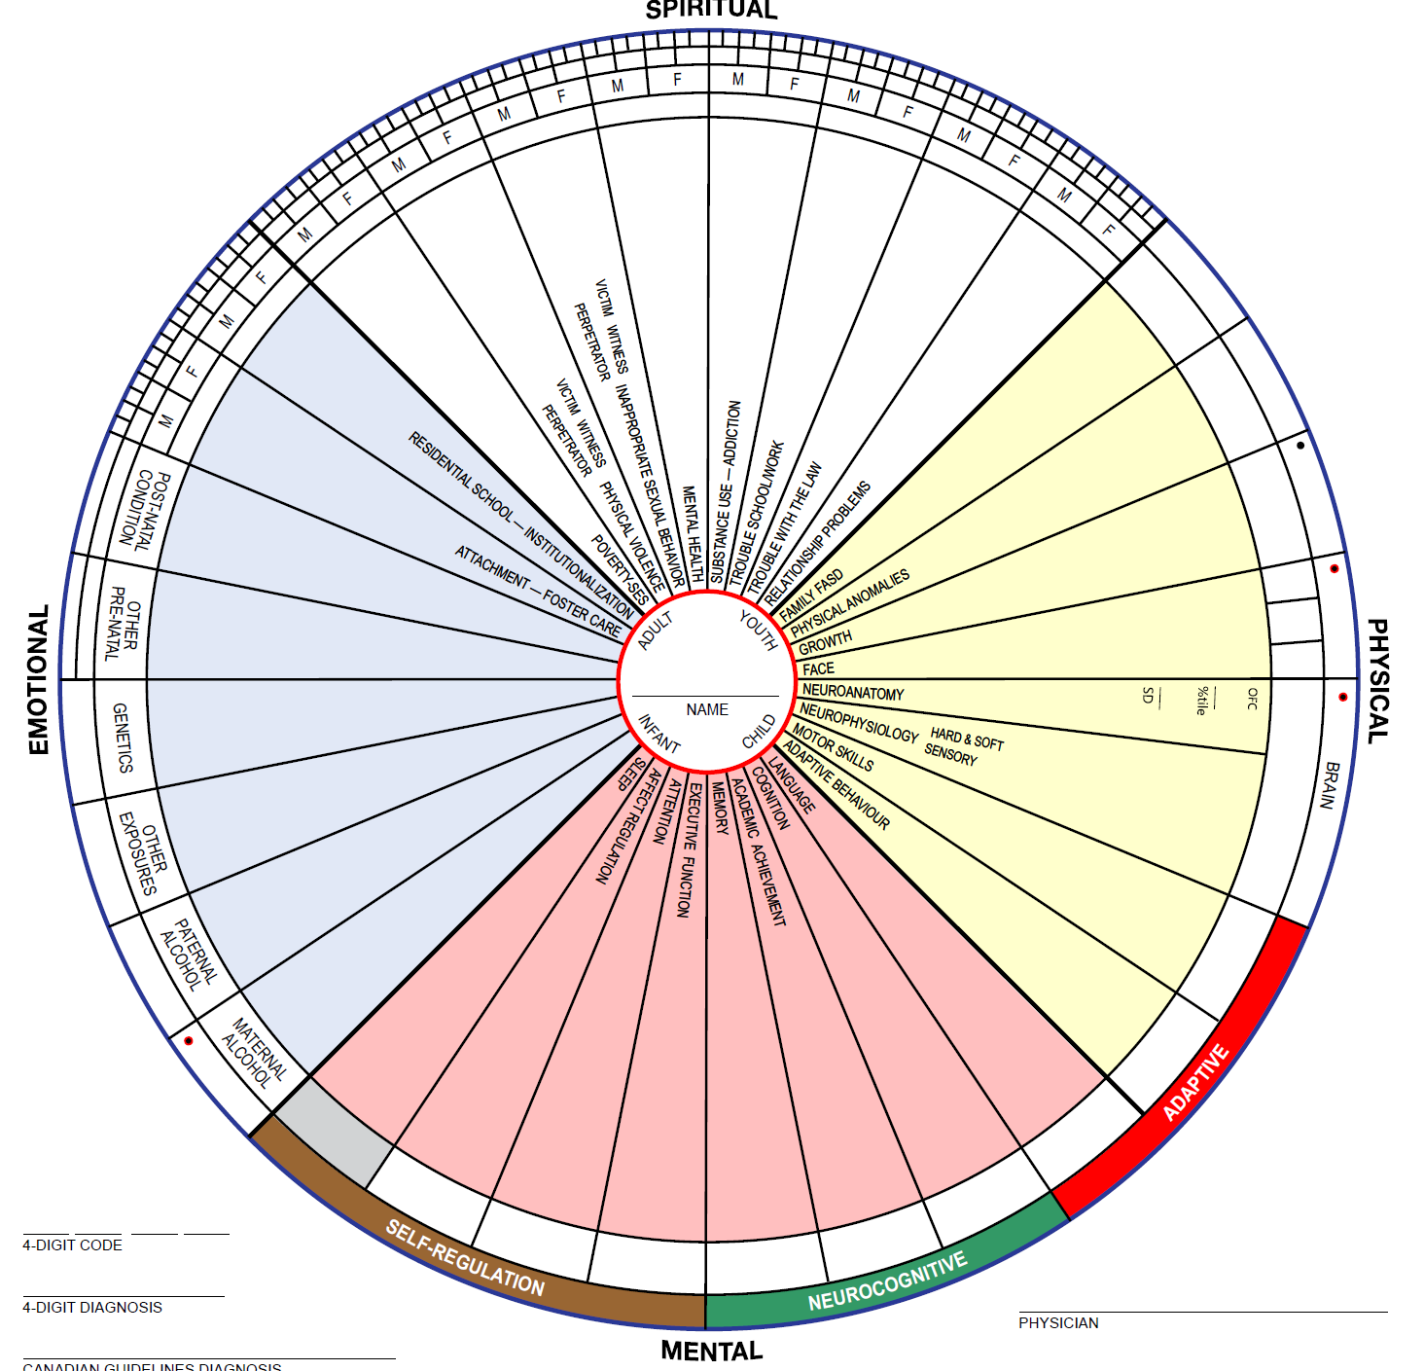

Slide 67
FASD Disorder--Disordering
Preventing FASD for Indigenous people is not just about providing diagnosis and programs
It has to do with healing the legacy of the past
Recognizing the social structures continue today to engender inequities and inequality in Canadian social institutions
Ensuring that the needs of Indigenous children and families especially those with trauma based disorders like FASD are fully met

Slide 69
Eastern Door FN Community System
Youth suicide rate significantly decreased
Youth HS graduation rate increased
Community based services and specialists
Training for school, health, justice professionals
Earlier interventions at school and at home
Youth trouble with CJS significantly reduced
Prevalence of FASD reduced

Slide 70

Reduction in Prevalence FASD
1999-2000 2019-20
FAS (FASD W/SFF) 5.3% 0%
FASD (pFAS,ARND 15.5% 12.5%
Total 20.8% 12.5%

Slide 71
Despite The Successes at ED
Young adults with FASD in the community have no support services and they continue to get in trouble with the CJS—funding stops after 18
Whole family systems are affected and there is inadequate funding for family system healing
Basic social needs of Indigenous families in terms of food security, good water and housing are often unmet as are cultural and spiritual needs

Slide 72
Still No Core Funding
For Eastern Door Programs--Diagnostic Team, Nogemag Youth Healing Lodge, Family Outreach
Yet Eastern Door has managed to survive for almost 20 years
Many youth and children in the community have gone through the Eastern Door MW assessment and interventions

Slide 73
Hope and Healing
Many ED youth now are adults with families of their own—working in fishery, store and even the school—avoiding the often revolving door of the Criminal Justice System
There is hope in the spirits of the youth and Elders in the community
There may be cure for FASD but there is healing

Slide 74
A FN Mom Talks About Diagnosis
At first I dreaded going (to get her assessed)….and didn’t know….didn’t want to know…but I put all those feelings aside and said this is for her….she asked me a lot of questions (in the interview) and I just answered them in my honest way as best as I could…..what I know….but she helped me figure out stuff in my head…about it….

Slide 75
A FN Mom Talks About Diagnosis
Just talking to her was a relief….for me….that it had a name… the doctor told me that this is what it is and then what they were going to do and every word he was saying after that…it was lifting my spirits and then things started going more easier after that and both of us….and she started to learn and when she first started reading a book I cried….I never thought she would read a book…and I was so happy…when she graduated high school…Thank you Eastern Door

Slide 76
Elder Informed Services
Listening to Indigenous Elder and giving them a seat at the table informs and improves mainstream clinical practice in terms of FASD disorders

Slide 77
TES Approach
As Elder Albert Marshall noted TES is a ‘way of doing things’ a collaborative practice (Marshall 2022). M’ikmaq Elder Charles Labrador said “Go into the forest and see birch, maple and pine---look underground and all those trees are holding hands. We as people must do the same”. (Iwama et al 2009)

Slide 78
The end
More information and access to all the tools: www.easterndoor.ca

