Slide 1


Senate of Canada Reports

Slide 2
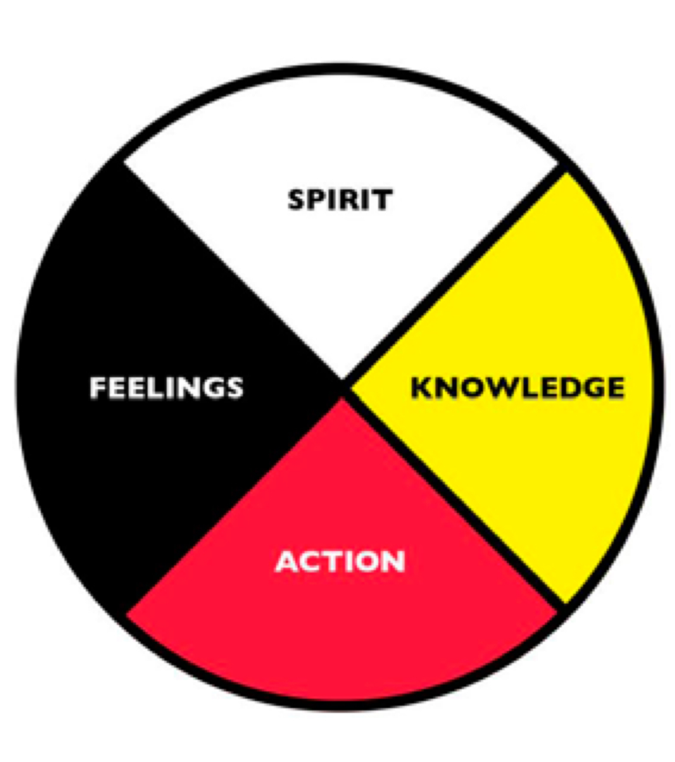
The Medicine Wheel

